Slide 1
International Lead Conference - Pb 2025
Amsterdam, 27.06.2025
“The political context in Europe from the perspective of the Non-Ferrous Metals Industry”

Slide 2
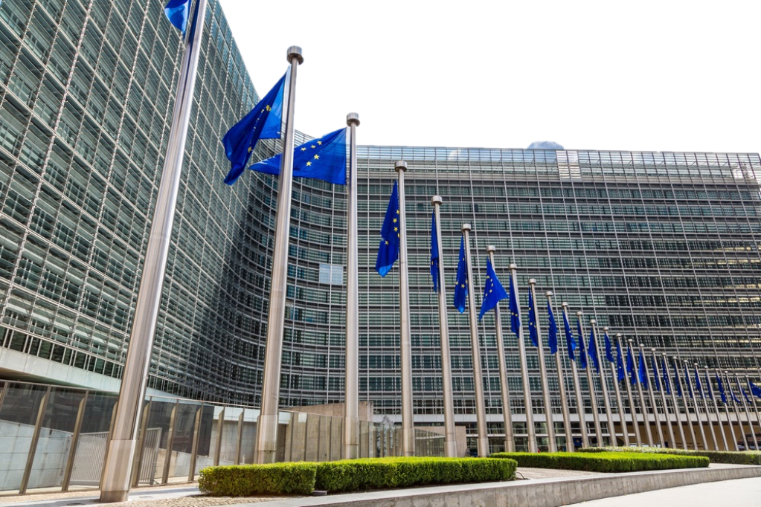
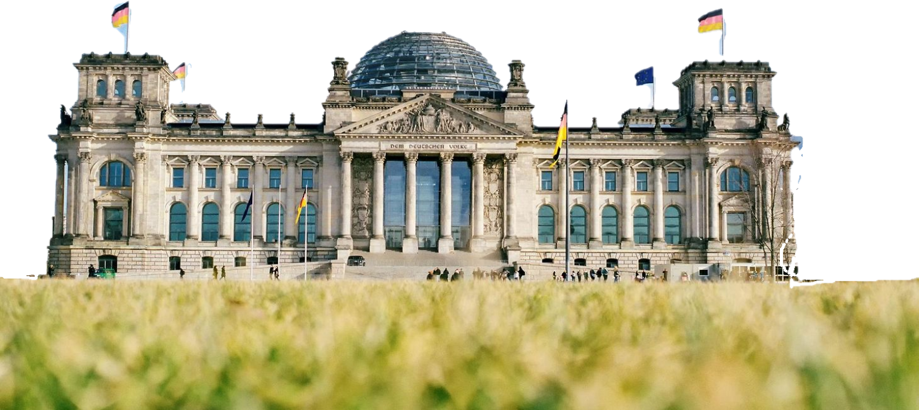
The WVMetalle on-site
Berlin
Advocacy
for the (NF) metals industry
Brussels
Headquarters of the association is in Berlin
The WVMetalle is additionally represented through its European office in Brussels

Slide 3
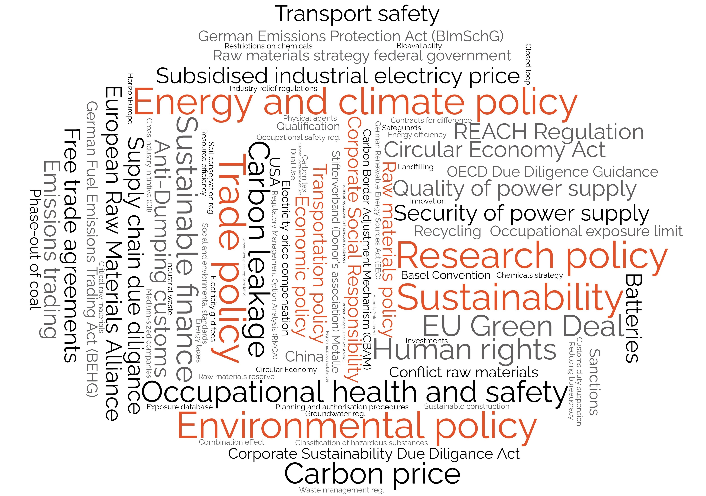
Variety of topics of the NF-metallindustry

Slide 4
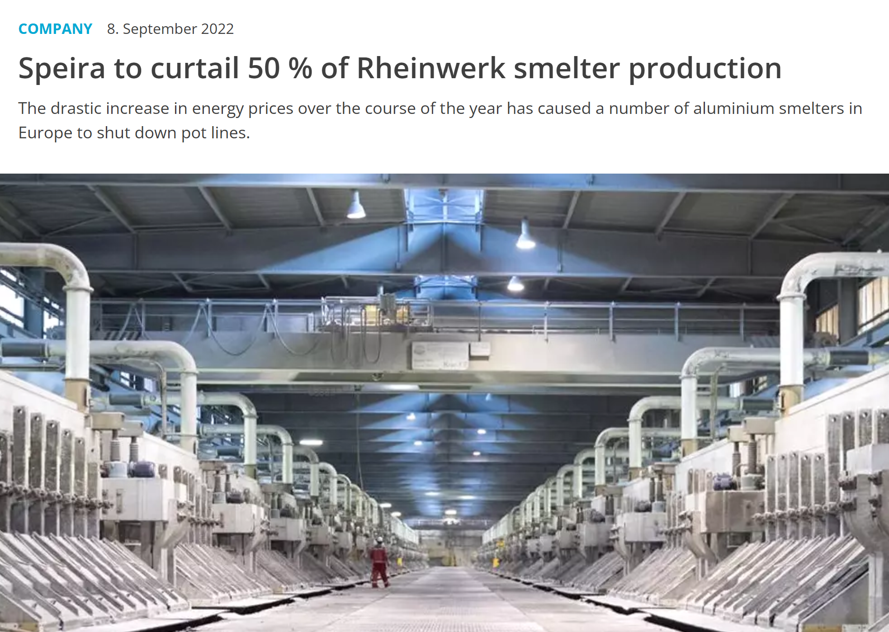
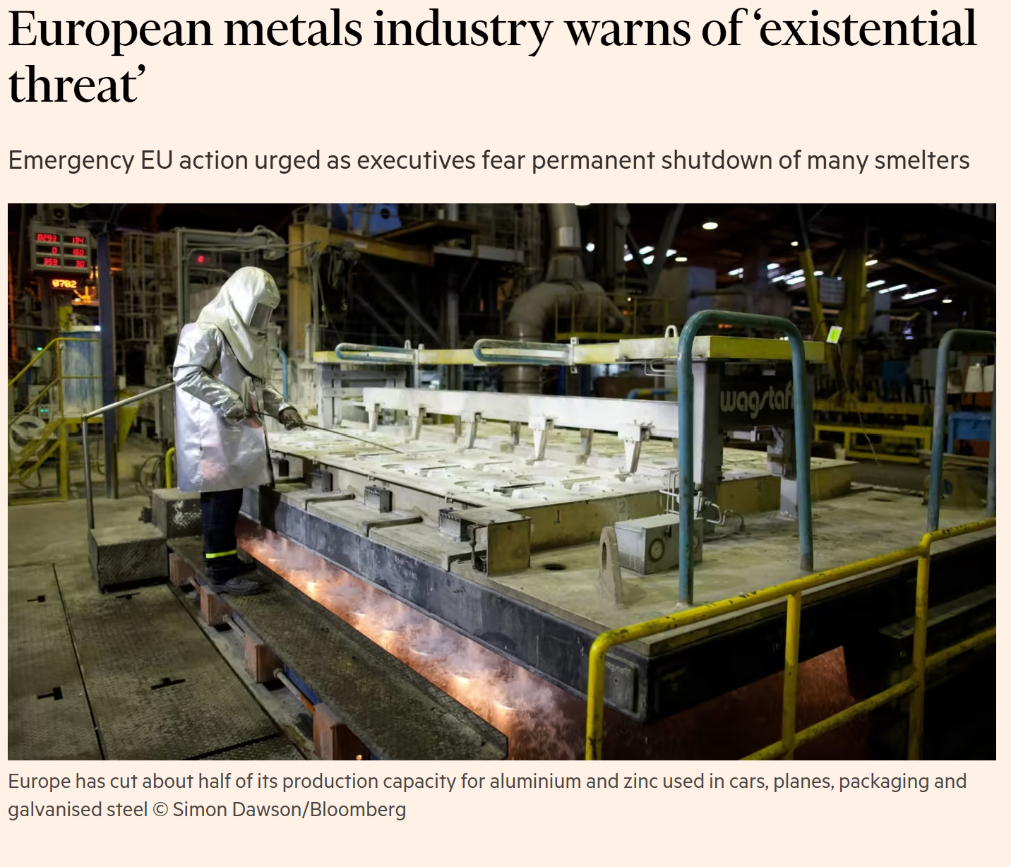
NF metal industry in Europe – Last years

Slide 5
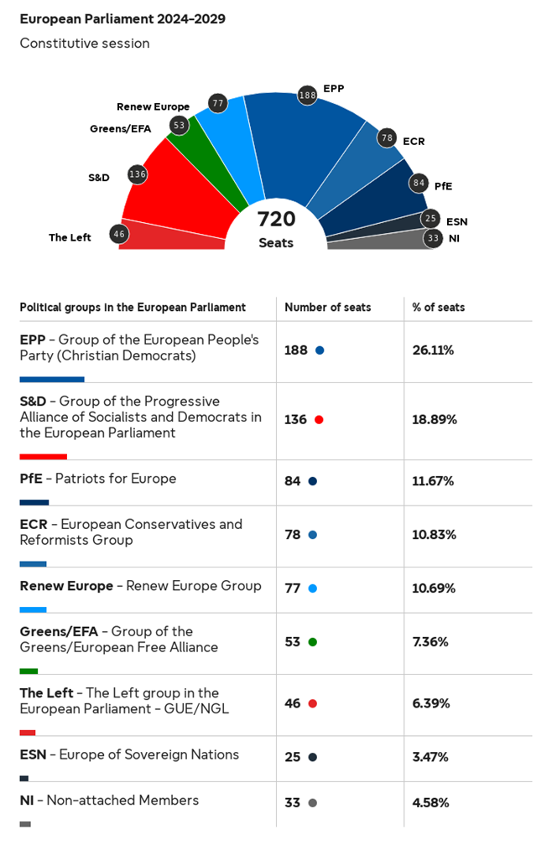
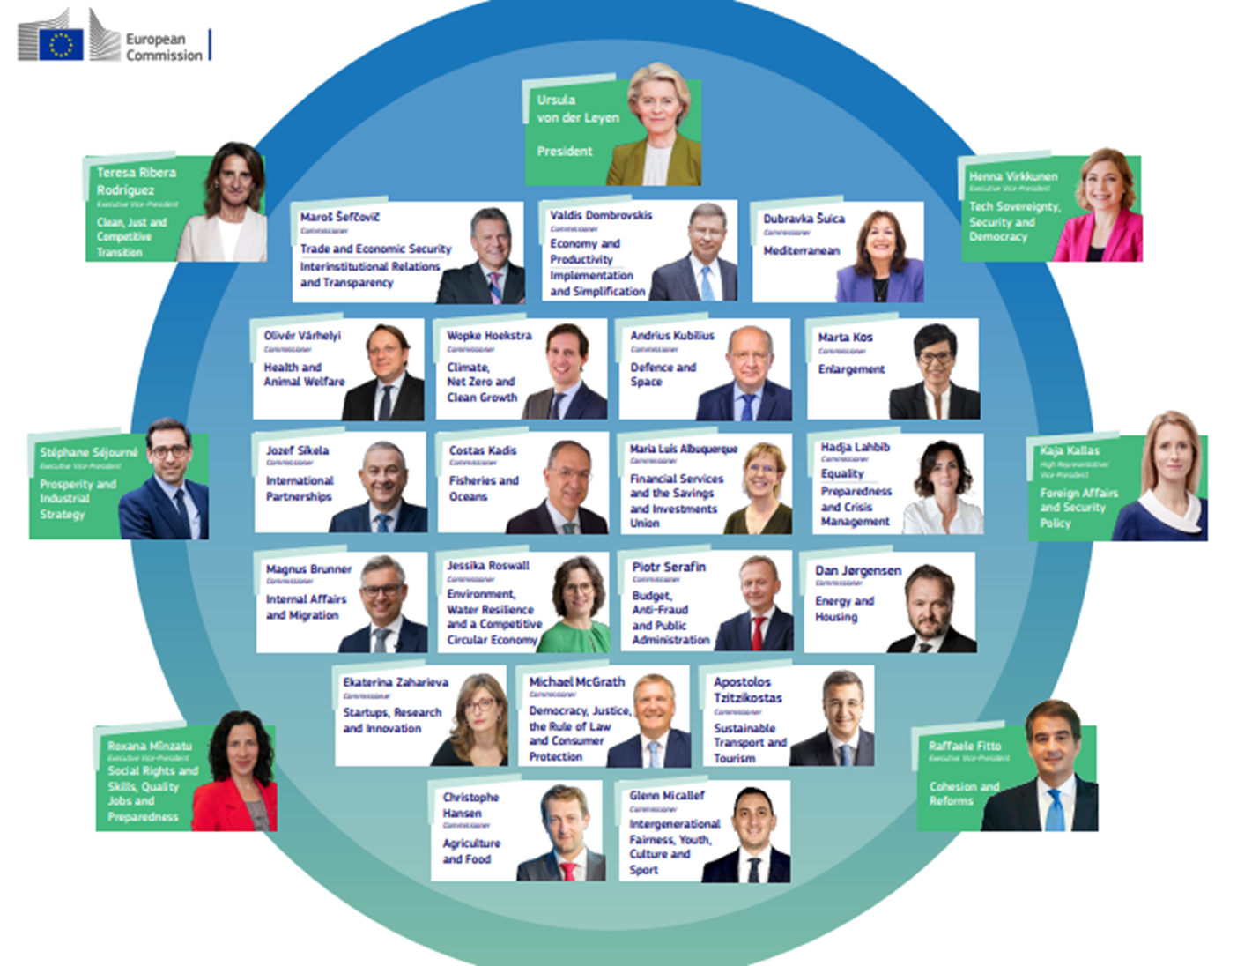
New European Political Landscape

Slide 6
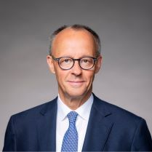
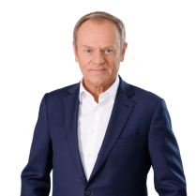
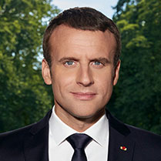
Old and new political leadership

Slide 7
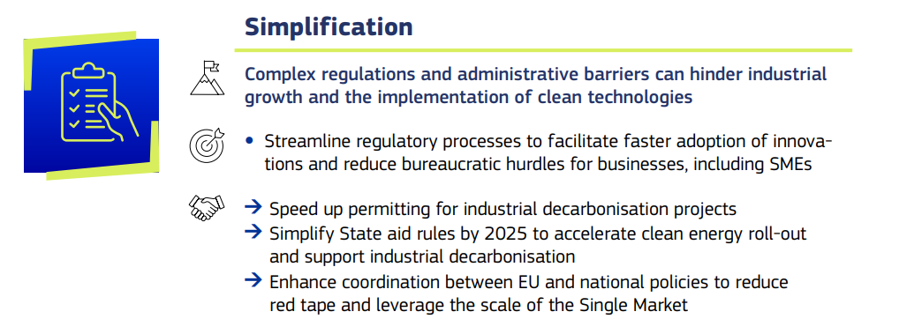
From Green Deal to Clean Industrial Deal
Affordable Energy
Lead markets
Financing
Circularity & Access to Materials
Global Markets and International Partnerships
Skill Enhancement

Slide 8
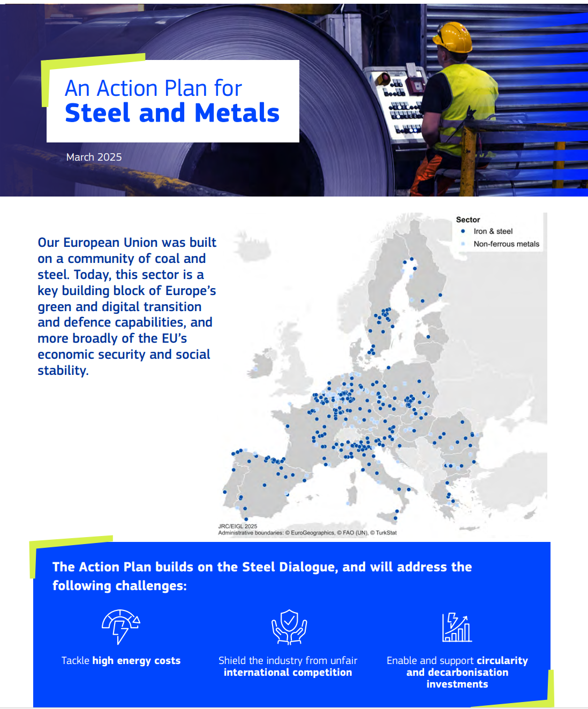
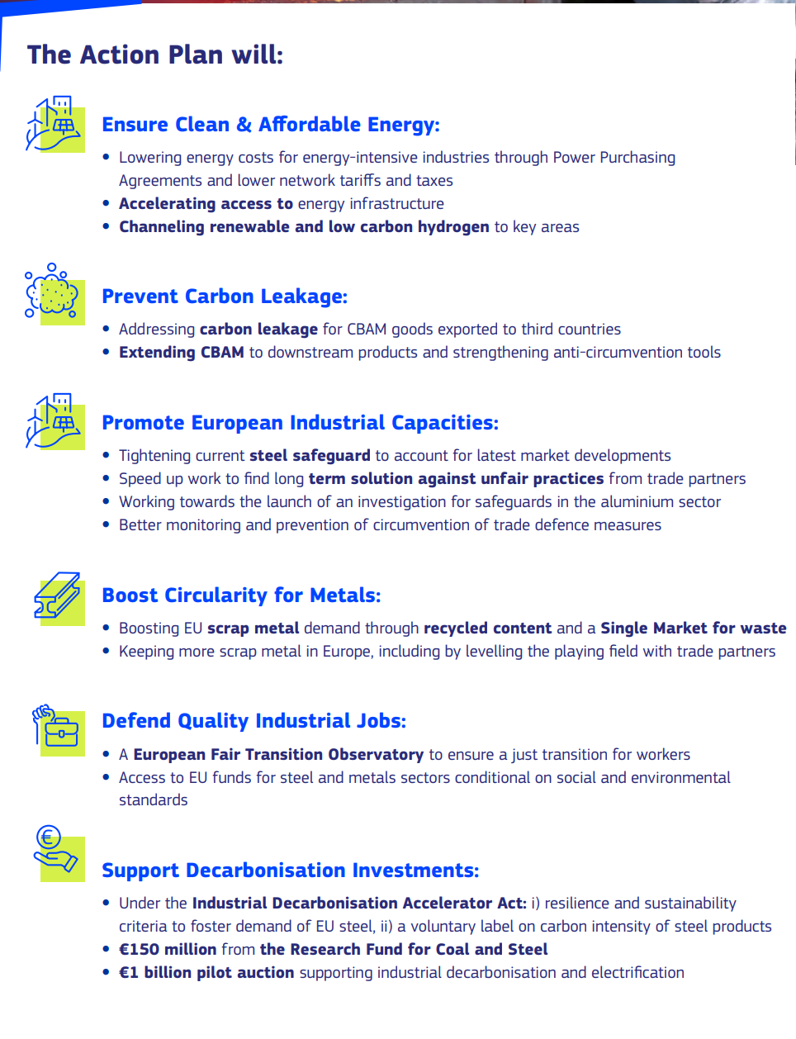
Steel and Metals Action Plan

Slide 9
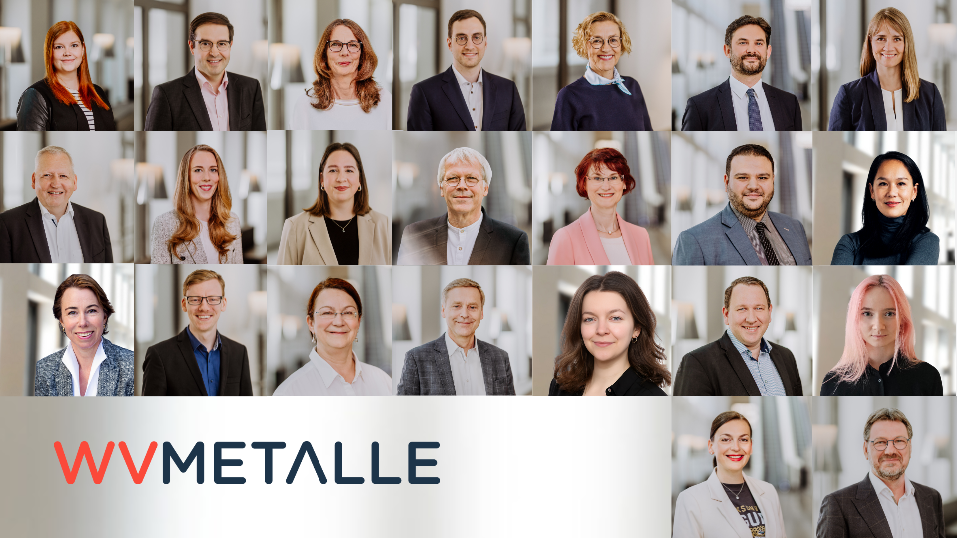
Thank you for your attention!

Slide 10
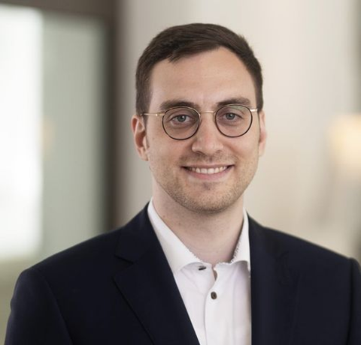
Contact details
Johannes Appel
Head of European Office | Chemical policy
Phone: +32 2 502 1988
Mobil: +49 151 40474794
E-Mail: appel@wvmetalle.de

