Slide 1
Carbon Footprint of lead bases batteries Requirements, methods and reduction
ILA Pb 2025, Amsterdam | Georg Meckl | 27th of June 2025

Slide 2
Agenda
1
Article 7 – Battery Regulation Timeline
Request from Customers and CSRD
Reporting requirements - public reports
What is a Carbon Footprint?
Life Cycle Assessment vs Carbon Footprint
Company Carbon Footprint vs Product Carbon Footprint (PCF)
Battery Regulation Requirements
Battery services and functional unit
System Boundaries
Modelling of a Lead Based Battery
Data collection
primary and secondary data, reference flow
Data quality
Cradle to Gate PCF
Conclusions
2
3
4
5
6
7
8
9

Slide 3
Article 7 Battery Regulation
Timeline
Art. 7 Carbon Footprint (CF)
April 2025: The Joint Research Centre (JRC) of the European Commission has now published their report on methodological guidelines for calculating the carbon footprint of rechargeable industrial batteries with a capacity greater than 2 kWh.
The European Commission will now use the JRC report to draft the delegated act establishing the methodology for the calculation and verification of the carbon footprint. (For industrial batteries (>2 kWh) this was originally scheduled to be adopted by 18 February 2025.) Although delayed, the delegated act is still expected by the end of this year.
Given the logic of Art. 7.1b, the carbon footprint declaration for industrial batteries (>2kWh) will now likely apply from 1st half of 2027 onwards (18 months after the date of entry into force either of the delegated act).
…nevertheless…

Slide 4
Request from Customers and CSRD
Customer and CSRD reporting requirements beyond Battery Regulation
Customers request information about the product carbon footprint of lead based batteries including
Batteries below 2 kWh
SLI batteries
In the light of the Corporate Sustainability Reporting Directive (CSRD) many of our customers need to report CO2 emissions of their company which includes purchased goods as one category of Scope 3 involving lead based batteries and therefore requesting primary data from us as a supplier.
e.g. Exide Technologies gets requests from Automotive OEMs, distributors, Industrial UPS and Telecom customers as well as established forklift and cleaning machine manufacturers.
In addition to customers, the CSRD requires the Carbon footprint of the product use phase as a further Scope 3 category although excluded in the battery regulation
Why?

Slide 5
Reporting Requirements
Public Version of the carbon footprint report
Content
Battery Model
Location Manufacturing Plant
Total PCF per Functional Unit (fU)
PCF per Life Cycle Stage per fU
Reference Year
DQR Score
Initial and final Usable Energy Capacity of the fU
Total PCF over Lifetime
Application, service life (either cycles or years)
Exact test procedures to determine service life/lifetime
Information about the datasets used
Electricity Modelling
Information on allocations
Information on recycled content and EoL modelling

Slide 6
What is a Carbon Footprint?
Life Cycle Assessment vs Carbon Footprint
Life Cycle Assessment (LCA)
A methodology used to evaluate the overall environmental impacts associated with all stages of a product's life cycle, from raw material extraction (cradle) to disposal or recycling (grave).
Carbon Footprint
Why?
The Product Carbon Footprint represents the Global Warming Potential (Climate change) which is usually expressed in Kilograms of CO2 equivalents and is one impact category.
EF 3.1 (Environmental Footprint 3.1) package is recommended to evaluate the environmental impacts such as
Climate change [kg CO2 eq.]
Acidification [mole of H+ eq.]
Eutrophication [kg P or N eq.]
Ecotoxicity [CTUe]
….and many more
The LCA (life cycle assessment) evaluates all environmental impacts.
The Carbon Footprint is one criteria out of this
…nevertheless…

Slide 7
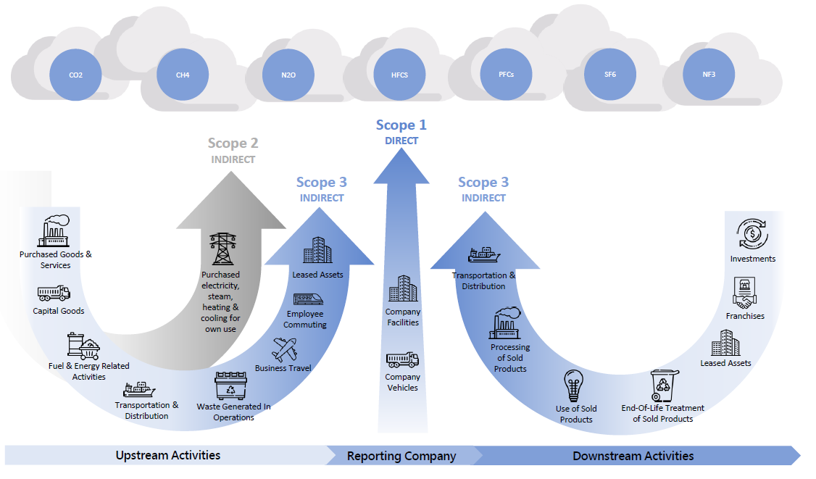
What is a Carbon Footprint?
Company Carbon Footprint vs Product Carbon Footprint
Raw material manufacturing
Manufacturing
Distribution
End of life
While a company carbon footprints accounts for the CO2 emissions of an organization , the PCF shows the GHG for a product during its life cycle stages. The use of sold products is excluded in the PCF according to Battery regulation.
Emissions of the different steps of a product life cycle can be fully (solid line) or partially (dotted line) allocated to the categories defined by the GHG Protocol to calculate an organizational footprint.

Slide 8
Battery Regulation Requirements
Battery Services and Functional Unit for Lead based batteries
Basically, the JRC report distinguishes between custom-made (CM) and off the shelf (OtS) batteries.
We stay with OtS in this presentation as it represents most products.
Rechargeable Lead
The Carbon Footprint
based batteries fulfill 2 fundamentally different services (functional unit)
will be calculated as CO2 equivalents (kg) emitted during the life cycle phases divided by
Repetitive Provision of electricity to e.g. industrial vehicles (REP)
Provision of back-up power on demand (OND)
The total energy (kWh) for REP → kg CO2 / kWh (cycles acc. to Article 10 / Annex IV)
Total amount of backup energy (kW × min) over the entire service life kg CO2 / kW×min×year (Power acc.to Article 10 / Annex IV)
PCF = CO2 eq / functional unit

Slide 9
Battery Regulation Requirements
System Boundaries
The system boundaries of a product life cycle defines the parts and life cycle stages for the battery concerned.
Lead based batteries the JRC proposal includes the following life cycle stages:
Raw Material manufacturing
Manufacturing
Distribution
End of Life
The life cycle phase “use of product” is not included for the PCF according to the battery regulation.

Slide 10
Modelling of a Lead Based Battery
It is all about input and output flows – simplified PCF Model for lead based forklift battery
Refined Lead
Lead Alloys
Additives; Fibers; Water,Sulphuric Acid
COS alloy, bushings; posts
Cables
Steam
Box, lid, valves
Sulfuric Acid; Water
Plugs
Separator
Auxilliaries
Lead oxide production
Grid manufacturing
Paste Mixing, Pasting & Drying, Curing
Plates
Assembly
Formation
cells
Tray Assembly for truck batteries
LIFE CYCLE STAGES
Raw material manufacturing
Manufacturing
Distribution
End of life
Final battery
Transport of the final battery to the place where it is brought into the market
Mandatory company-specific activity data
Mandatory company-specific processes
Non- Mandatory company-specific act. Data
Secondary dataset process (see JRC default)
Battery dismantling, breaking and conversion into recycled materials

Slide 11
Data Collection
Primary and Secondary Data
Primary data shall be collected for all mandatory company specific processes and activities in the main production and distribution; they describe inputs and outputs of the processes concerned e.g.:
Inputs
Outputs
Material inputs in kg; if in liquid state (electrolyte) the specific concentration is needed
Direct and indirect energy (electricity, natural gas, steam, fuels..) strong link to scope 1 and 2 of the company's carbon footprint
Other material inputs required for the manufacturing process (e.g. refrigerants, chemicals for wastewater treatment)
Transport of goods
Other Elementary flows
Material outputs including waste water
Elementary flows (e.g. direct emission to air like loss of refrigerants or leakages to ground)

Slide 12
Data Collection
Reference Flow
The reference flow is the total mass of the battery to fulfill the functional unit and defines the quantities and type of materials and energy which are needed.
All inputs and outputs are understood in relation to the amount specified for the reference flow.
The Bill of Materials should help for primary data generation to calculate the reference flow
usually, it defines already the needed process steps to manufacture the functional unit
it contains input and output materials for each process step including scrap levels
ideally contains energy allocations to processes
Plant specific Energy and EHS reports are very useful to identify further emissions and energy or fuel consumptions (e.g. natural gas, propane, oxygen, coal). Such inputs generally need to be allocated to the processes (e.g. input per kg or kWh of annual production).
Further inputs shall come from the up and downstream supply chain – like transport information of materials and the distribution of the batteries in scope.
1
2
3

Slide 13
Data Collection
Data Quality Rating (DQR)
The Public version of the Carbon Footprint report needs to contain a value about the Data Quality Rating (DQR)
The DQR value is derived from the data quality rating of each dataset used in the PCF model
Two ratings about representativeness are applied for each data set
TeR = Technological Representativeness
GeR Geographical Representativeness
The individual Quality Ratings (1-5) and the rating descriptions are provided in the JRC methodology proposal
The DQR value itself is the average of the individual numbers weighted by the respective Carbon footprint of each process/flow
The Non-public version of the CF report includes also the detailed ratings for each data set

Slide 14
Cradle to Gate PCF
Industrial AGM > 2 kWh
1
Refined Lead and Lead alloys deliver the biggest contribution – as expected → focus on the use of less and/or secondary material including optimized transport.
Energy contribution depends a lot on the country mix and could be significantly higher than in this example → use of renewable energy; GoO (guarantee of origin) to improve the energy mix.
Plastics CF depends on the amount and purity → re-design of Box/Lid and use of 2ndary would reduce PCF.
2
3

Slide 15
Conclusions
The due Date for Product Carbon Footprint declaration is delayed vs original time plan
Customer and CSRD requirements goes beyond the Battery Regulations requirements
The work on modelling and data collection for the PCF report is time consuming, complex and request different fields of expertise
The use of adequate Software is mandatory and requires additional training for the users
3rd party verification is requested by stakeholders which consumes more resources
1
2
3
4
5
…if not yet done let’s start the work now…

Slide 16
Thank you!

